Slide 1



Blockchain for Migrants
FinclusionChain Team

Slide 2


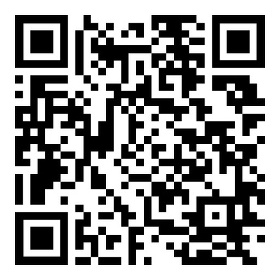
Problem statement
Millions of migrants lack access to loans and financial services
Causes: missing credit history, incomplete ID documents, weak banking infrastructure
SCAN ME 🌐

Slide 3

Why This Matters to Us
We are migrants living across the world.
Different professions, same migrant journey.
We know the barriers — banking, loans, access.
This is personal, not just research.
Our mission: make finance inclusive for migrants.
SCAN ME 🌐

Slide 4



Research Question
Can blockchain-based credit systems provide a viable solution to financial exclusion among migrants and refugees who lack access to traditional banking services?
SCAN ME 🌐

Slide 5

Why Blockchain?
Portable and secure digital credit profiles.
Verifiable and trusted across borders.
Bypasses traditional banking barriers.
Promotes financial inclusion globally.
SCAN ME 🌐

Slide 6

Key Insights from Research
Migrant-heavy regions often show strong adoption of digital finance.
Blockchain tools can fill the gap for those excluded from banking.
Countries like the USA, India, and the Philippines highlight overlap.
Decentralized platforms offer real alternatives for underserved populations.
SCAN ME 🌐

Slide 7



Who We’re Reaching:
Our outreach strategy focuses on building meaningful connections with both organizations and individual innovators who share our mission of improving financial inclusion for migrants.
Organizations:
Individuals:
ID2020
CARE
Ashutosh Bhatt
Kristy
Kim
United Nations
Alliance for Financial Inclusion
Misha
Esipov
Mariano
Sanz
SCAN ME 🌐

Slide 8




Why Them?
United Nations (UN) → Global voice for migrant rights & inclusion.
Alliance for Financial Inclusion (AFI) → Shapes inclusive finance with regulators.
CARE → Grassroots reach in migrant communities.
Ashutosh Bhatt → Financial inclusion advocate.
Misha Esipov → Cross-border credit innovator.
Mariano Sanz → Migrant-focused entrepreneur.
Kristy Kim → Builds alternative financial access models.
SCAN ME 🌐

Slide 9
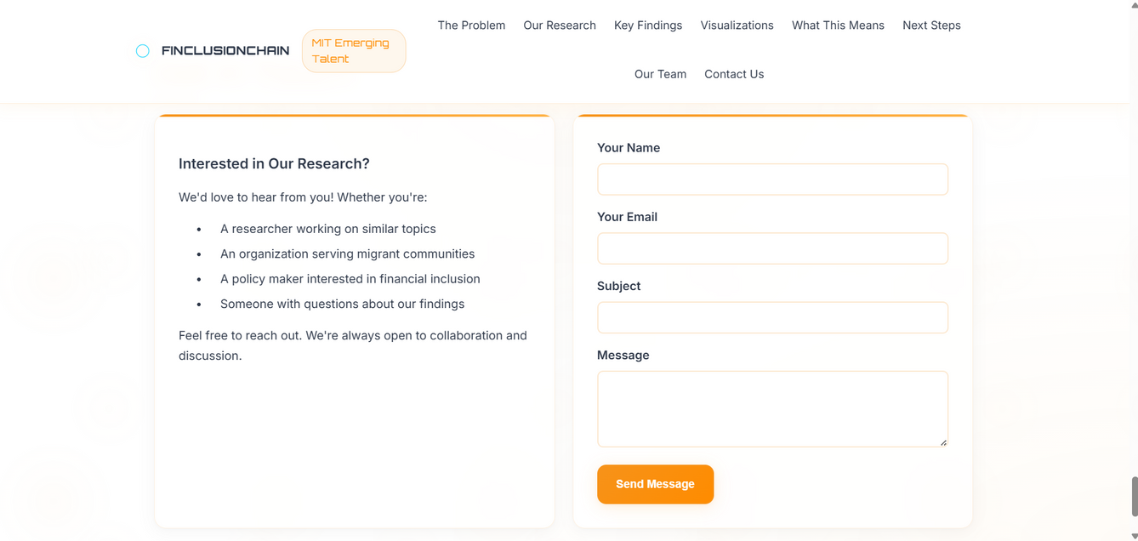
How We Reach Them
Email outreach → Personalized messages
to key individuals.
Website → Share findings, insights, and updates.
Social Media & LinkedIn → Amplify our
message and connect with networks.
Engagement → Invite collaboration from organizations & innovators.
SCAN ME 🌐

Slide 10
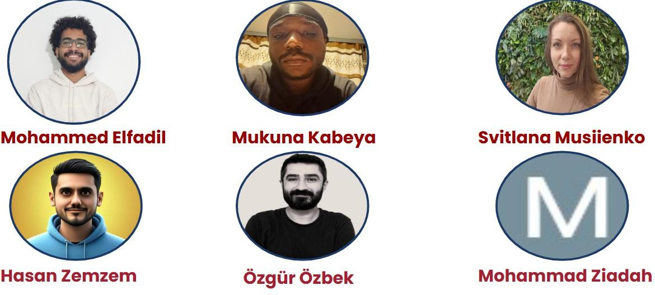
Meet the Team:
SCAN ME 🌐

